Slide 1
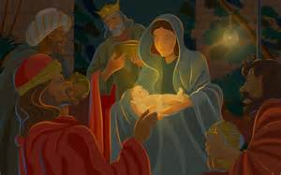
Lessons and carols

Slide 3
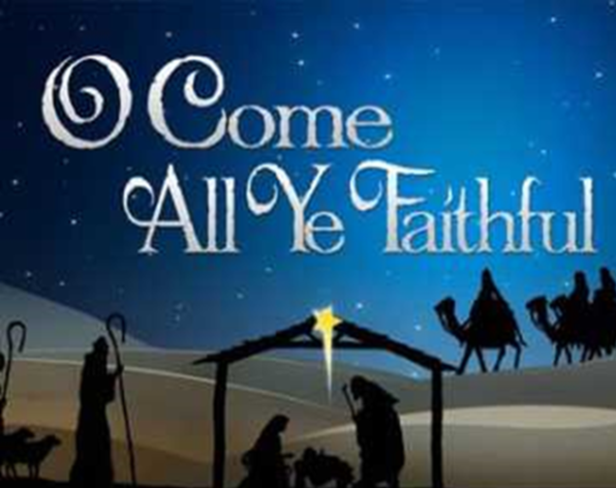
Processional Hymn
O come all ye faithful
Processional Hymn

Slide 4
Oh come all ye faithful, Joyful and triumphant,
Come ye O come ye to Bethlehem;
Come and behold Him born the King of angels:
O come let us adore him,
O come, let us adore him,
O come, let us adore him, Christ the Lord

Slide 5
2.True God of true God,
Light of Light eternal,
Lo, he abhors not the virgin’s womb;
Son of the Father, begotten not created;
O come, let us adore him, O come, let us adore him,
O come, let us adore him, Christ the Lord.

Slide 6
First Lesson:-
Luke 1: 26-35,38.
The angel Gabriel announces to Mary that she will bear a holy Child

Slide 7
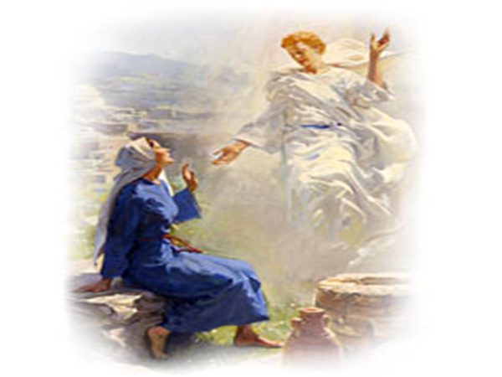

Slide 8
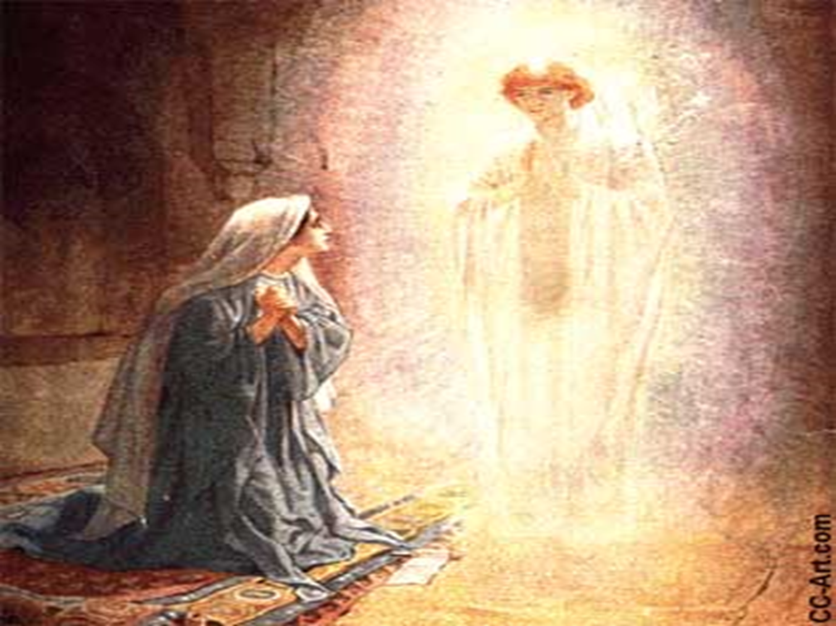

Slide 10
Charles Wesley

Slide 11
Second Lesson:-
Luke 2:1-7.
Joseph and Mary travel to Bethlehem, where Mary gives birth to her child

Slide 12
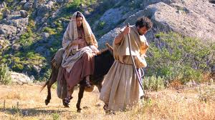

Slide 13
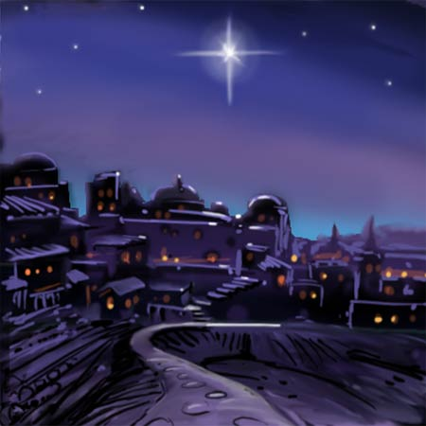

Slide 14
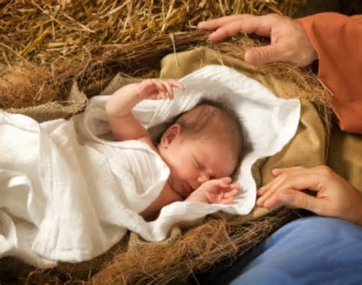

Slide 16
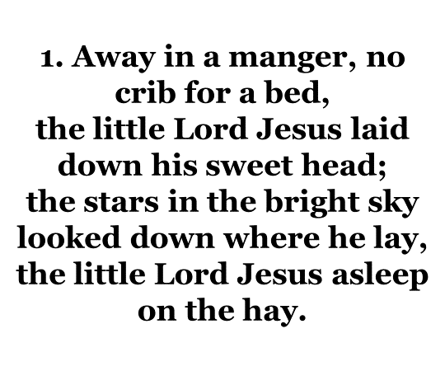

Slide 18
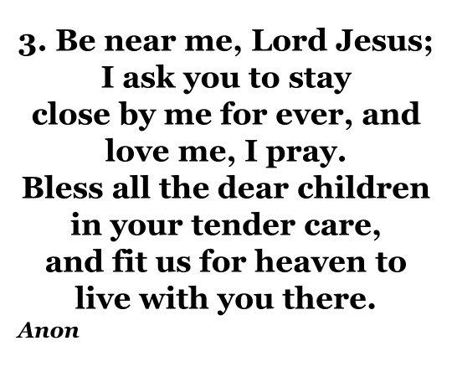

Slide 19
Third Lesson:-
Luke 2:8-16.
Angels appear to the Shepherds in the fields and announce the birth of the Messiah

Slide 20
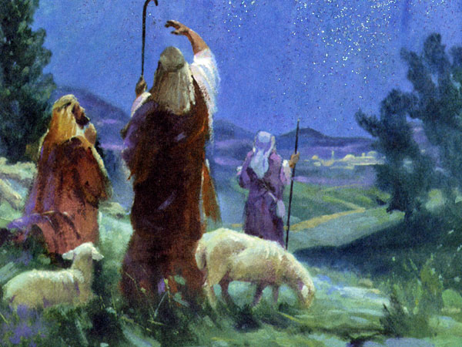

Slide 21
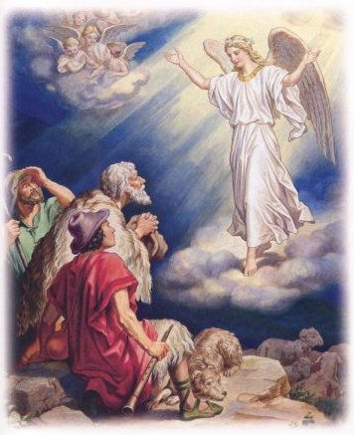

Slide 22
Glory to God in the highest heavens
And on earth peace among those who he favours

Slide 24
1. The First Noel, the Angels did say
Was to certain poor shepherds in fields as they lay
In fields where they lay keeping their sheep
On a cold winter's night that was so deep.
Noel, Noel, Noel, Noel
Born is the King of Israel!

Slide 25
2. When they looked up and they saw a star
Shining in the East beyond them far,
And to the earth it gave great light
And so it continued both day and night.
Noel, Noel, Noel, Noel
Born is the King of Israel!
Anon 17th century

Slide 26
Fourth Lesson:-
Matthew 2:1-11
Magi from the East come seeking the Messiah and offer gifts to the baby Jesus

Slide 27
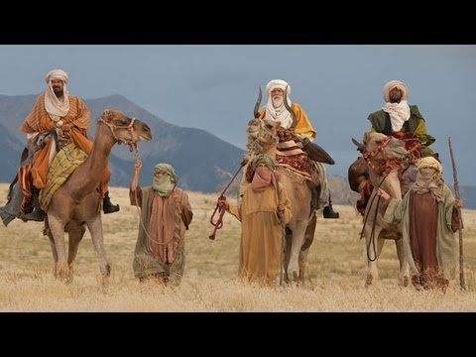

Slide 28
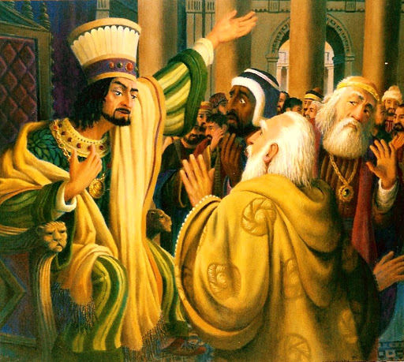

Slide 29
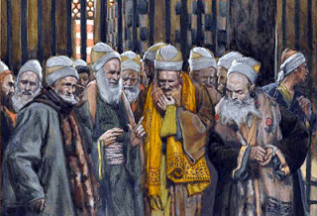

Slide 30
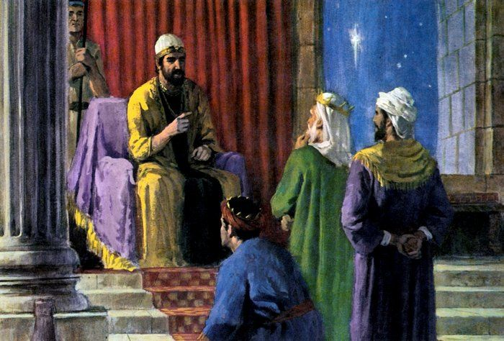

Slide 31
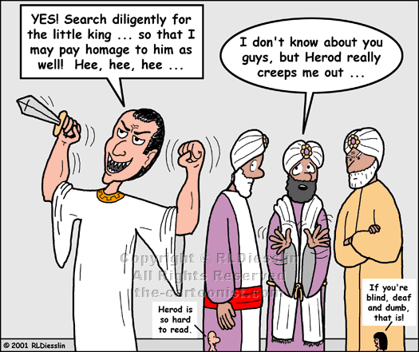

Slide 32
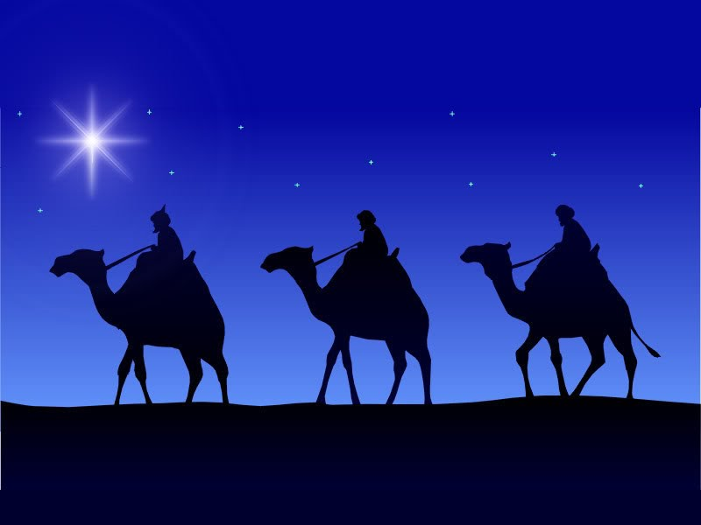

Slide 33
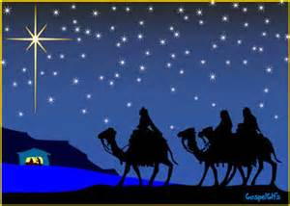

Slide 34
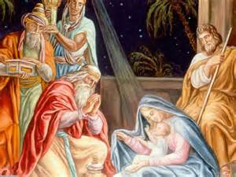

Slide 35
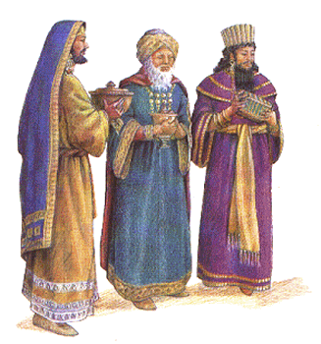

Slide 37
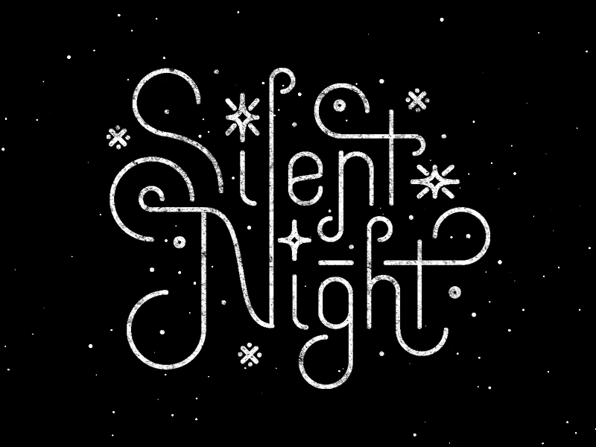

Slide 38
1. Silent night, holy night, all is calm all is bright
Round yon virgin mother and child,
Holy infant so tender and mild,
Sleep in heavenly peace,
Sleep in heavenly peace,

Slide 39
2. Silent night, holy night, shepherds quake at the sight,
Glory streams from heaven afar,
Heavenly hosts sing Alleluia;
Christ the saviour is born
Christ the saviour is born

Slide 40
3. Silent night, holy night, wondrous star lend your light
With the angels let us sing,
Alleluia to our king;
Christ our saviour is born
Christ our savour is born.
Joseph Mohr 1792-1848

Slide 41
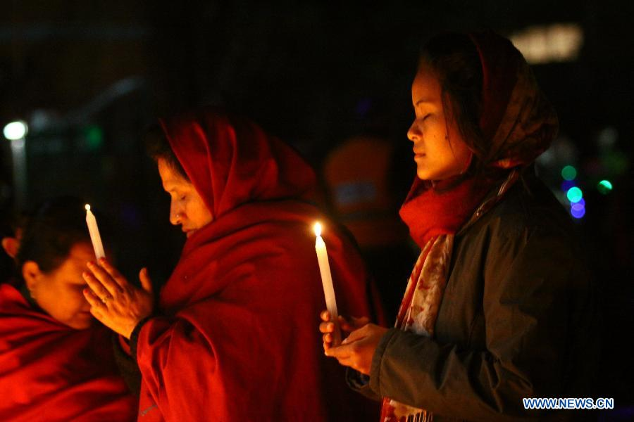
Prayers of the people

Slide 42
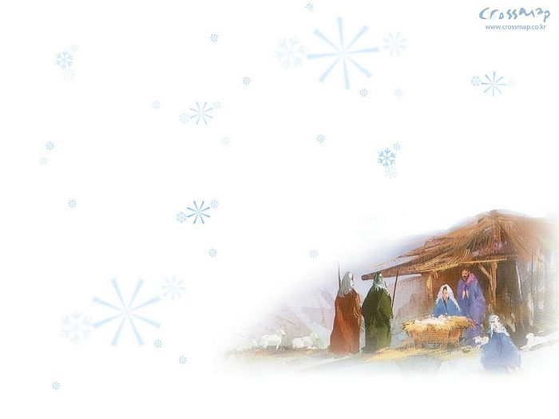
Our Father, which art in heaven
Hallowed be Thy name
Thy Kingdom come,
Thy will be done on earth
as it is in heaven.
Give us this day our daily bread
And forgive us our trespasses, as we forgive those who trespass against us
And lead us not into temptation, but deliver us from evil,
For thine is the kingdom, and the power and the glory for ever and ever.
Amen.

Slide 44
1. Joy to the world! The Lord has come;
let earth receive her king;
let every heart prepare him room,
and heaven and nature sing,
and heaven and nature sing,
and heaven, and heaven and nature sing.

Slide 45
2. Joy to the world! The Saviour reigns;
let men their songs employ;
while fields and floods, rocks, hills and plains
repeat the sounding joy,
repeat the sounding joy,
repeat, repeat the sounding joy.

Slide 46
3. He rules the world with truth and grace,
and makes the nations prove
the glories of his righteousness
and wonders of his love
and wonders of his love,
and wonders, wonders of his love.
Isaac Watts 1674-1748
Based on Psalm 98

Slide 47
Dismissal and Benediction
Amen

Slide 48
